Slide 1

Day 2 : Snowflake Objects and SQL Commands
By Gurleen Kaur

Slide 2
Day 2 Agenda
01
02
Snowflake Objects
SQL Commands
Databases, schemas, tables, views, and stored procedures
DDL, DML, and query constructs for effective data manipulation
03
04
Data Loading
Stage Management
Loading data from AWS S3 using COPY INTO and Snowpipe
Internal and external stages with file format specifications
By the end of this session, you'll understand the core components that make Snowflake a powerful platform for modern data engineering and analytics workloads.

Slide 3
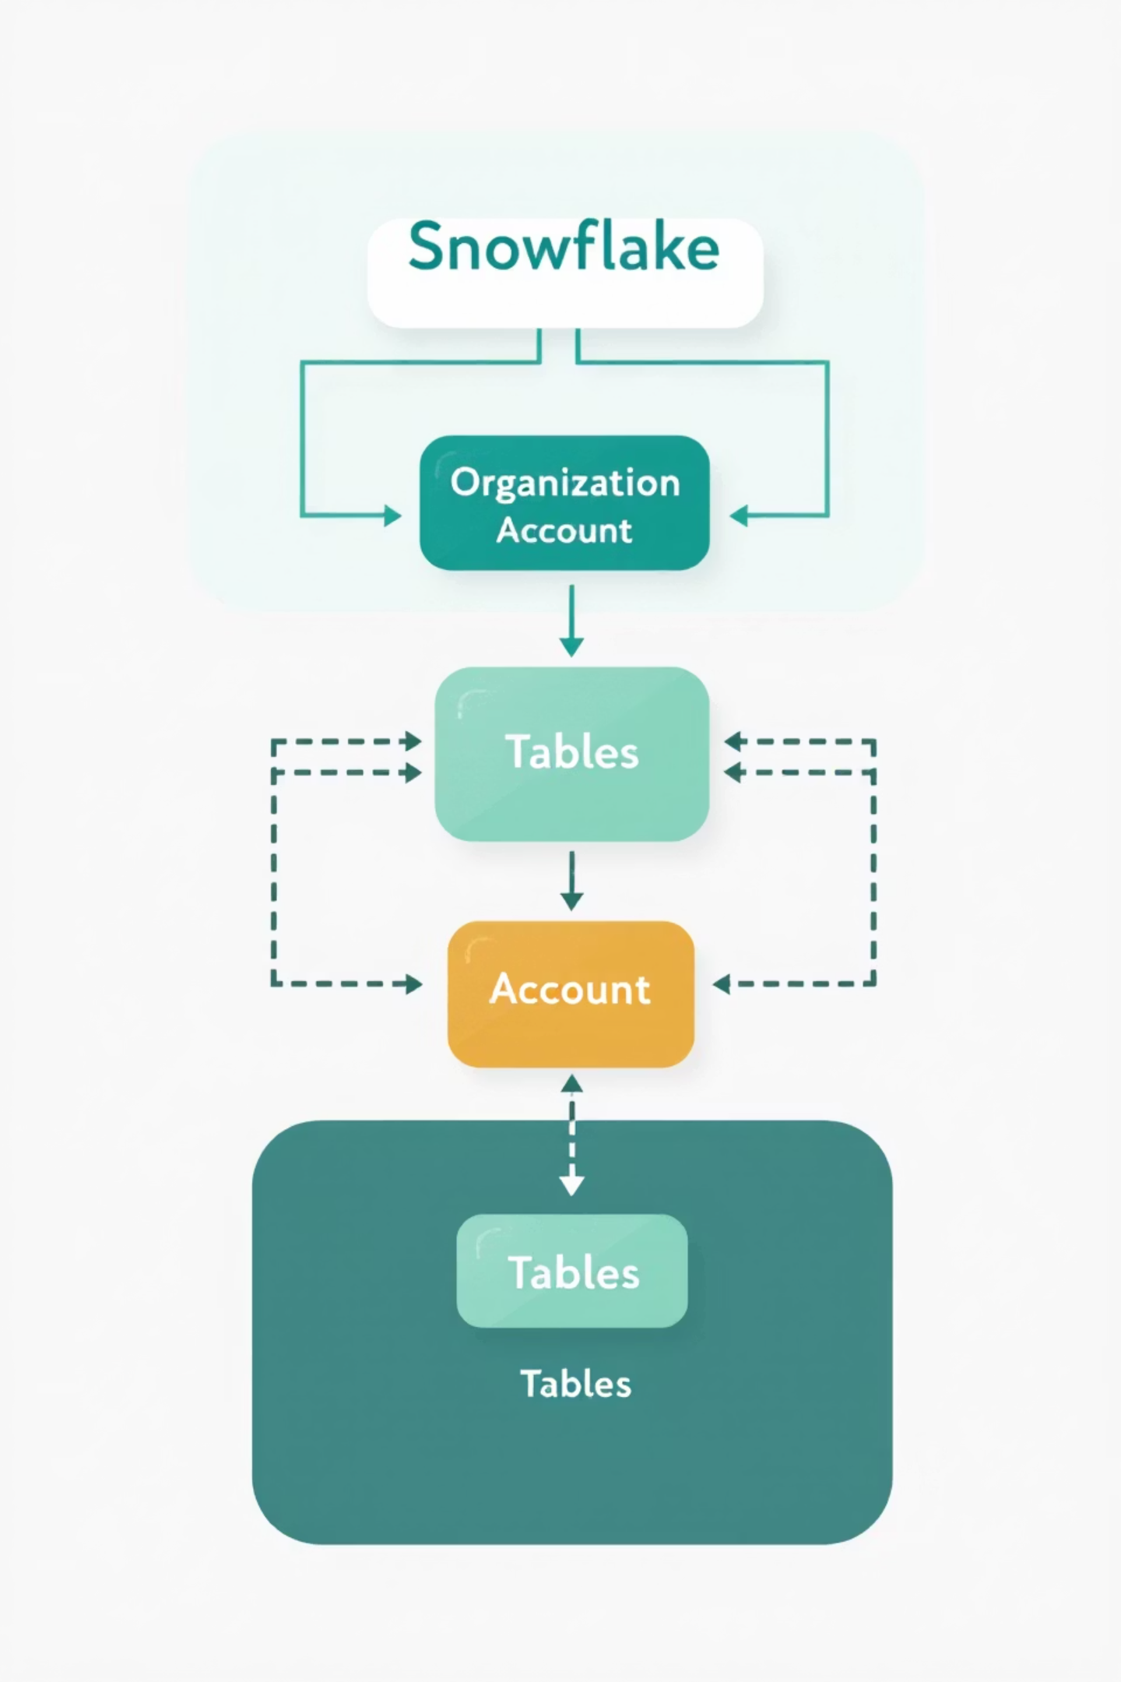
Snowflake Object Hierarchy
Organization & Account
The top-level container that holds all your Snowflake resources. Organizations can contain multiple accounts for dev/test/prod environments.
Databases
Logical containers for organizing schemas. Unlike traditional databases, Snowflake databases are lightweight and you can create many without performance overhead.
Schemas
Namespaces within databases that organize database objects like tables, views, and procedures. A single database can contain hundreds of schemas.
Objects
Tables, views, stored procedures, and other database objects that store or process your data.

Slide 4
Databases, Schemas and Tables
Databases
Table Types
Top-level containers that organize related schemas.
Permanent: Default type, persists until explicitly dropped
Transient: No Fail-safe period, lower cost for temporary workloads
CREATE DATABASE sales_data;USE DATABASE sales_data;
Temporary: Session-specific, automatically dropped when session ends
Schemas
Logical groupings of database objects.
CREATE TRANSIENT TABLE customer_staging ( id INTEGER, name VARCHAR(100), email VARCHAR(255));
CREATE SCHEMA sales_data.transactions;USE SCHEMA sales_data.transactions;
Choose the right table type based on data importance, retention needs, and cost considerations.

Slide 5
Working with Database Objects
Working Efficiently with Objects
-- Create a databaseCREATE DATABASE sales_data;-- Create a schemaCREATE SCHEMA sales_data.transactions;-- List schemas in databaseSHOW SCHEMAS IN DATABASE sales_data;-- Set context (important!)USE DATABASE sales_data;USE SCHEMA transactions;
Always set your session context to avoid fully qualifying object names in every statement
Use descriptive naming conventions (e.g., db_env_purpose)
Consider data isolation needs when planning your hierarchy
Keep development, testing, and production in separate databases
Pro tip: Use INFORMATION_SCHEMA views to programmatically explore object metadata instead of SHOW commands.

Slide 6

Permanent Tables
Key Characteristics
Default table type in Snowflake
Persist until explicitly dropped
Full data protection with Time Travel and Fail-safe
Higher storage costs due to retention features
Support for clustering keys to optimize query performance
CREATE TABLE customer_orders ( order_id NUMBER, customer_id VARCHAR(20), order_date DATE, amount DECIMAL(12,2))CLUSTER BY (order_date);
Permanent tables are ideal for critical business data that requires point-in-time recovery and protection against accidental deletion.

Slide 7
Transient & Temporary Tables
Transient Tables
Temporary Tables
No Time Travel or Fail-safe protection
Exist only for the duration of the session
Lower storage costs (30-50% cheaper)
Automatically dropped when session ends
Persist until explicitly dropped
Only visible to the creating session
Ideal for intermediate ETL results
Perfect for query-specific transformations
CREATE TRANSIENT TABLE staging_dataAS SELECT * FROM raw_data;
CREATE TEMPORARY TABLE session_metricsAS SELECT user_id, COUNT(*) FROM events GROUP BY user_id;
When working with large datasets, temporary tables can significantly improve query performance by materializing intermediate results. Transient tables strike a balance between cost and persistence.

Slide 8

Standard Views
What Are Standard Views?
Virtual tables defined by a query that dynamically retrieves data from underlying tables each time the view is referenced.
No physical storage (query executed on-demand)
Always returns current data
Can join across multiple tables
Simplifies complex queries
Controls access to sensitive columns
CREATE VIEW customer_sales_summary ASSELECT c.customer_name, c.region, SUM(o.amount) as total_salesFROM customers cJOIN orders o ON c.id = o.customer_idGROUP BY c.customer_name, c.region;
Standard views can also be used to implement row-level security by including WHERE clauses that filter data based on the current user.

Slide 9



DDL, DML, and Query Constructs
Data Definition Language (DDL)
Data Manipulation Language (DML)
Query Constructs
Commands that define and modify database structures
Commands that manipulate data within database objects
Advanced features for data analysis
Window functions
CREATE, ALTER, DROP, TRUNCATE
SELECT, INSERT, UPDATE, DELETE
Common Table Expressions (CTEs)
DESCRIBE, SHOW
MERGE, COPY
Semi-structured data functions (JSON, Parquet, Avro)
GRANT, REVOKE
UNLOAD
Snowflake supports the full ANSI SQL standard plus cloud-specific extensions, making it both familiar to SQL users and powerful for cloud data analytics.

Slide 10
Materialized Views
Key Features
Best Use Cases
Pre-computed results stored physically
Frequently accessed aggregations
Automatic incremental maintenance
Dashboards with common metrics
Significantly faster query performance
Complex joins that are reused
Consume storage space (unlike standard views)
When query latency is critical
Higher cost but much better performance
For improving BI tool performance
CREATE MATERIALIZED VIEW daily_sales_by_region ASSELECT DATE_TRUNC('day', order_date) AS day, region, SUM(amount) AS daily_totalFROM ordersJOIN customers ON orders.customer_id = customers.idGROUP BY 1, 2;
Unlike standard views, materialized views in Snowflake are automatically and incrementally refreshed when their base tables change, ensuring data is always current without manual refreshes.

Slide 11
Stored Procedures
JavaScript Procedures
SQL Procedures
More flexible, can include control logic, API calls, and complex operations.
Simpler to write, ideal for straightforward database operations.
CREATE OR REPLACE PROCEDURE process_orders() RETURNS STRING LANGUAGE JAVASCRIPT AS $$ var sql_command = `INSERT INTO order_summary SELECT date_trunc('month', order_date), SUM(amount) FROM orders WHERE processed = false GROUP BY 1`; var stmt = snowflake.createStatement( { sqlText: sql_command }); var result = stmt.execute(); return "Processing complete"; $$;
CREATE OR REPLACE PROCEDURE update_inventory() RETURNS STRING LANGUAGE SQL AS BEGIN UPDATE inventory i SET stock_level = i.stock_level - (SELECT SUM(quantity) FROM order_items oi JOIN orders o ON oi.order_id = o.id WHERE o.status = 'SHIPPED' AND o.processed = false AND oi.product_id = i.product_id); UPDATE orders SET processed = true WHERE status = 'SHIPPED' AND processed = false; RETURN 'Inventory updated'; END;

Slide 12
SQL Command Types
1
2
3
DDL (Data Definition Language)
DML (Data Manipulation Language)
DQL (Data Query Language)
CREATE, ALTER, DROP, TRUNCATE, RENAME
SELECT statements for data retrieval
INSERT, UPDATE, DELETE, MERGE
Define and modify database structures
Modify data stored in tables
Complex joins, window functions
MERGE for upsert operations
Snowflake-specific functions
CREATE or REPLACE to update object definitions
Multi-table INSERT with subqueries
Semi-structured data queries (FLATTEN, PARSE_JSON)
UNDROP to recover accidentally dropped objects
Snowflake extends standard SQL with specialized functions for working with semi-structured data, geospatial data, and time series analysis. These extensions make complex data processing significantly easier compared to traditional databases.

Slide 13
Snowflake-Specific SQL Features
Semi-structured Data
Zero-Copy Cloning
-- Query JSON dataSELECT raw_data:customer.name::STRING, raw_data:customer.email::STRING, raw_data:items[0].product_id::NUMBERFROM json_orders;-- Flatten arraysSELECT value:idFROM json_orders,LATERAL FLATTEN(input => raw_data:items);
-- Clone a table (no physical copy)CREATE TABLE orders_backupCLONE orders;-- Clone a database at a point in timeCREATE DATABASE sales_backupCLONE sales AT(TIMESTAMP => '2023-06-15 13:00:00'::TIMESTAMP);
Data Sharing
Time Travel
-- Create a shareCREATE SHARE marketing_share;-- Grant usage on databaseGRANT USAGE ON DATABASE analytics TO SHARE marketing_share;-- Add consumer accountALTER SHARE marketing_share ADD ACCOUNTS = abc123.us-east-1;
-- Query data as it was 2 hours agoSELECT * FROM orders AT(OFFSET => -60*60*2);-- Restore a dropped tableUNDROP TABLE accidentally_dropped;-- Restore a table to a specific timeCREATE TABLE orders_fixed CLONE ordersBEFORE (STATEMENT => '019abc58-0001-0001');

Slide 14





User Roles and Access Control
ACCOUNTADMIN
1
Highest privilege, controls all aspects
SECURITYADMIN & SYSADMIN
2
User/role management & system object management
Custom Admin Roles
3
Database-level administration and monitoring
Functional Roles
4
Department-specific access with appropriate privileges
End-User Roles
5
Limited, purpose-specific data access for analysts, developers, etc.
Snowflake implements Role-Based Access Control (RBAC) with hierarchical role inheritance. Each user can have multiple roles and switch between them as needed.

Slide 15

Implementing Access Control
Role Management
Object Privileges
-- Create functional rolesCREATE ROLE marketing_analyst;CREATE ROLE finance_analyst;-- Grant access to rolesGRANT ROLE marketing_analyst TO USER jane_doe;-- Role hierarchyGRANT ROLE marketing_analyst TO ROLE department_lead;-- Set active roleUSE ROLE marketing_analyst;
-- Database-level accessGRANT USAGE ON DATABASE sales_data TO ROLE marketing_analyst;-- Schema-level accessGRANT USAGE ON SCHEMA sales_data.transactions TO ROLE marketing_analyst;-- Object-level privilegesGRANT SELECT ON TABLE sales_data.transactions.orders TO ROLE marketing_analyst;GRANT SELECT ON VIEW sales_data.reporting.dashboard_data TO ROLE marketing_analyst;
Never assign ACCOUNTADMIN to everyday users. Create custom admin roles with limited scope for specific administrative functions instead.

Slide 16




Best Practices & Key Takeaways
Object Organization
Table Choices
Follow a consistent naming convention and organize objects logically across databases and schemas. Consider using environment prefixes (DEV_, TEST_, PROD_).
Use permanent tables for critical data, transient tables for ETL, and temporary tables for session-specific work. Apply clustering keys to large tables with selective filters.
View Strategy
Security Model
Use standard views for data security and simplifying complex joins. Reserve materialized views for performance-critical aggregations accessed frequently.
Implement least-privilege access with functional roles. Use a role hierarchy that mirrors your organization structure. Regularly audit access patterns.
Remember that Snowflake separates storage and compute, which should influence your design decisions. Objects that consume storage (tables, materialized views) incur ongoing costs, while compute resources scale independently based on workload needs.
For complex operations, combine stored procedures with task scheduling to automate workflows and ensure consistency in your data processing pipelines.

Slide 17
User Roles and Access Control
Snowflake implements a role-based access control system that determines what actions users can perform on which objects. Roles can be assigned to users and hierarchically organized.
System-Defined Roles
Custom Roles
ACCOUNTADMIN: Top-level administration role with full control
Create role hierarchies for specific business needs
Implement least privilege principle
SECURITYADMIN: Manages users, roles, and privileges
Control access at database, schema, or object level
SYSADMIN: Creates and manages databases and warehouses
Apply column-level security for sensitive data
PUBLIC: Automatically granted to all users
Create custom role and grant privileges
CREATE ROLE data_analyst;GRANT USAGE ON DATABASE analytics TO ROLE data_analyst;GRANT USAGE ON SCHEMA analytics.marketing TO ROLE data_analyst;GRANT SELECT ON TABLE analytics.marketing.campaign_performance TO ROLE data_analyst;

Slide 18
Module 4: Data Loading in Snowflake Using AWS S3
Efficient strategies for bringing your data into Snowflake

Slide 19

Data Loading in Snowflake Using AWS S3
A comprehensive guide for data engineers and cloud architects to efficiently move data from AWS S3 to Snowflake, covering staging, loading mechanisms, automation, and optimization techniques for both batch and streaming workloads.

Slide 20
Agenda
1
2
3
Snowflake and S3 Integration Fundamentals
External Stages and File Formats
COPY INTO Operations
Configuring storage integration and defining structured access to your S3 data
Mastering batch loading with transformation capabilities and error handling
Understanding the architectural relationship between AWS S3 and Snowflake's data loading ecosystem
4
5
Snowpipe for Continuous Loading
Advanced Techniques and Optimization
Implementing automated, serverless, near real-time data ingestion
Performance tuning, cost management, and hybrid loading strategies

Slide 21
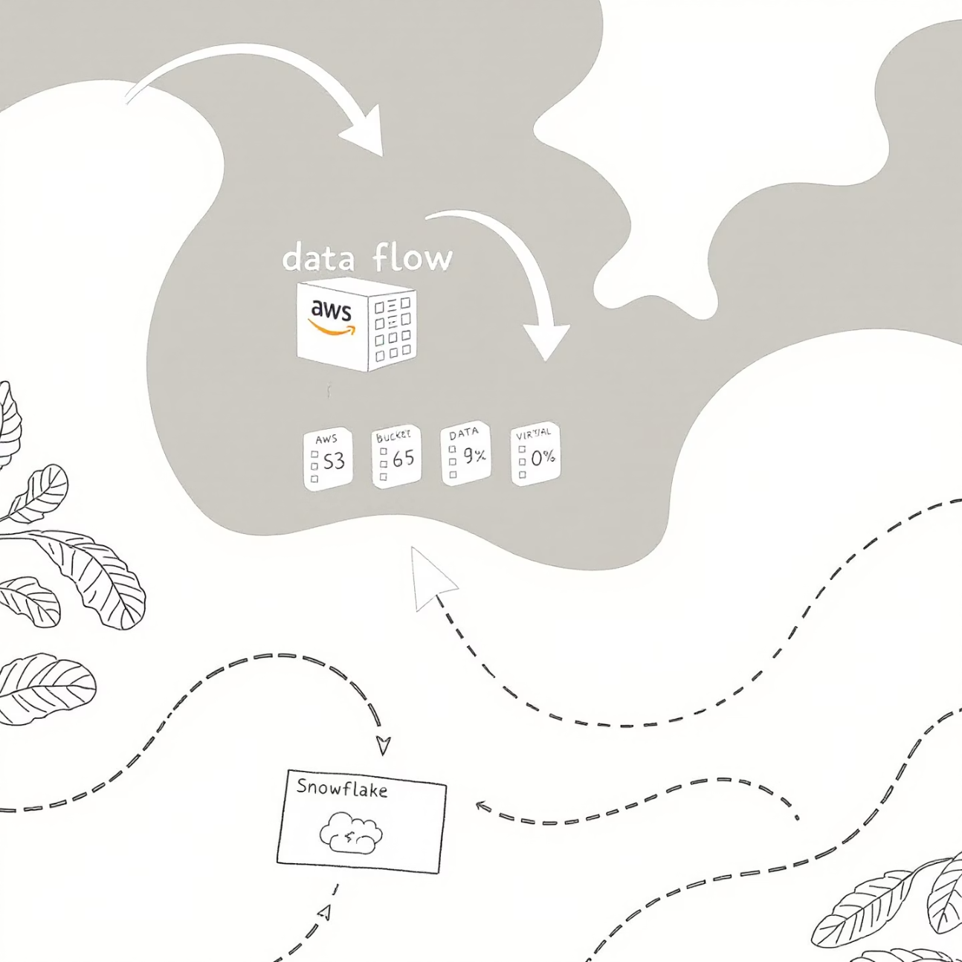
Snowflake and S3 Integration Architecture
Snowflake and AWS S3 create a powerful data pipeline through secure, high-throughput connections:
Storage Integration: Secure, credential-free authentication between Snowflake and S3
Internal vs. External Stages: S3 buckets can be referenced as external stages
Secure Access: IAM roles with least privilege principles
Data Transfer: Compute resources in Snowflake's virtual warehouses pull data directly from S3
Metadata Catalog: Snowflake maintains table metadata separate from storage

Slide 22
External Stages: Your Gateway to S3 Data
Creating an External Stage
Defining File Formats
Listing Files in Stage
CREATE STAGE my_s3_stage URL = 's3://my-bucket/path/' CREDENTIALS = (AWS_ROLE = 'arn:aws:iam::account:role/myrole') ENCRYPTION = (TYPE = 'AWS_SSE_KMS' KMS_KEY_ID = 'key_id');
CREATE FILE FORMAT my_csv_format TYPE = 'CSV' FIELD_DELIMITER = ',' SKIP_HEADER = 1 NULL_IF = ('NULL', 'null') EMPTY_FIELD_AS_NULL = TRUE;
LIST @my_s3_stage/daily_feeds/;
Verifies file availability before loading operations
Links Snowflake to your S3 bucket with secure role-based access
Tells Snowflake how to interpret data structures in your files
External stages provide the foundation for all data loading operations and can be reused across multiple workflows.

Slide 23

File Format Configuration Deep Dive
Supported File Types
Advanced Format Options
CSV/TSV: Delimiter options, quote handling, escape characters
Compression: AUTO, GZIP, BZ2, BROTLI, ZSTD, DEFLATE
JSON: Object or array formats with path extraction
Error Tolerance: SKIP_FILE, CONTINUE, ABORT_STATEMENT
Parquet: Column-oriented with schema inference
Date/Time Formats: Custom parsing patterns
Avro: Row-based binary format with schema registry support
Encoding: UTF8, UTF16, ISO-8859-1, etc.
ORC: Optimized Row Columnar for Hadoop ecosystems
Binary Format: HEX, BASE64 encoding for binary data
XML: With XPath expressions for element selection
Best Practice
Create separate file formats for each data source type and version them in your code repositories. File formats can be shared across multiple loading operations.

Slide 24
COPY INTO: The Workhorse of Batch Loading
COPY INTO sales_data FROM @my_s3_stage/sales/ FILES = ('sales_20230101.csv', 'sales_20230102.csv') FILE_FORMAT = (FORMAT_NAME = my_csv_format) PATTERN = '.*sales_[0-9]{8}\.csv' ON_ERROR = 'CONTINUE' VALIDATION_MODE = 'RETURN_ERRORS' FORCE = FALSE;
Key Parameters
Runtime Transformations
Parallel Loading
FILES vs. PATTERN: Explicit list or regex pattern matching
Column Selection: Load specific columns only
Warehouse Sizing: X-Large+ for maximum throughput
FORCE: Control file reloading behavior (deduplication)
Type Casting: Convert data types during load
File Sizing: Aim for 100-250MB compressed files
ON_ERROR: Error handling strategy
Expressions: Apply SQL functions during ingestion
File Count: Multiple files load in parallel
SIZE_LIMIT: Controls maximum bytes processed
COPY_HISTORY: Access load metadata for auditing
SPLIT: Break large files for better parallelization

Slide 25

Data Transformation During Load
Column-Level Transformations
COPY INTO customers( id, name, email, signup_date, status, loyalty_score)FROM ( SELECT $1::integer, INITCAP($2::string), LOWER($3::string), TO_DATE($4, 'MM/DD/YYYY'), IFF($5 = 'A', 'ACTIVE', 'INACTIVE'), ZEROIFNULL($6::number(3,1)) FROM @my_s3_stage/customers/)FILE_FORMAT = (FORMAT_NAME = my_csv_format);
Snowflake can transform data on ingestion, reducing the need for separate ELT steps. This approach leverages the compute power of your virtual warehouse during the load process itself.
Tip: For complex transformations, consider using a separate transformation layer or Snowflake Streams and Tasks for a more maintainable architecture.

Slide 26
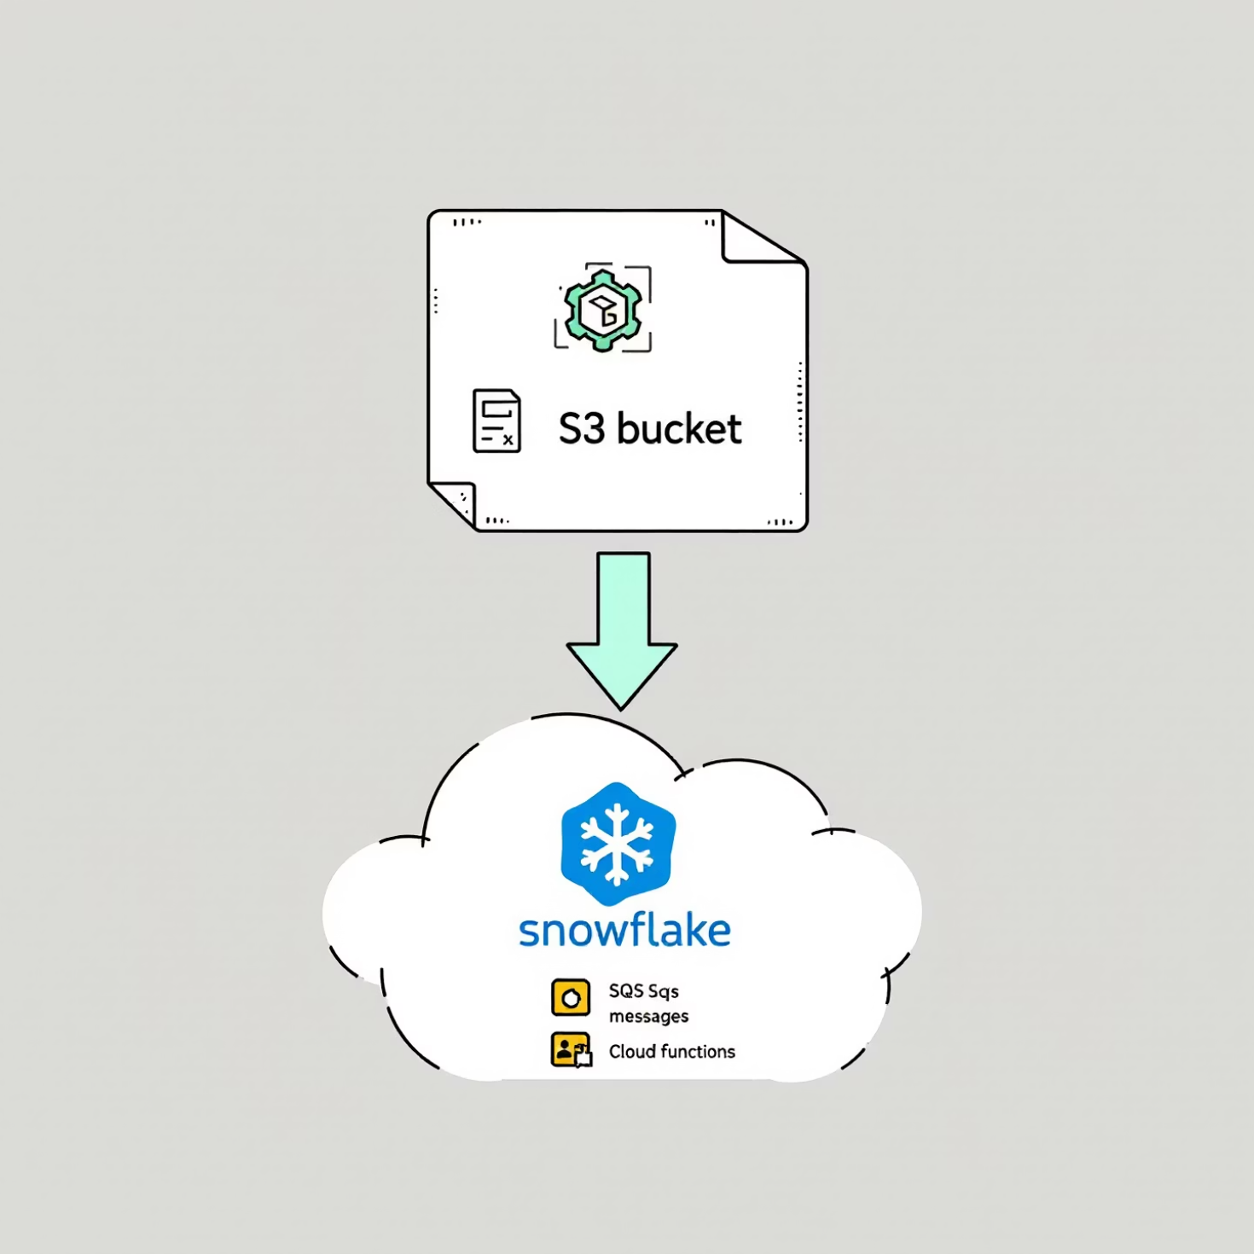
Snowpipe: Continuous Data Loading
Serverless, Near Real-Time Ingestion
Snowpipe provides automated, incremental data loading without managing virtual warehouses:
Event-Driven: Triggered by S3 events via SQS notifications
Serverless: Billed by compute seconds, not warehouse time
Auto-Ingest: Fully automated pipeline with event notifications
REST API: Programmatic control for custom integration
Manifest Files: Track loading state for reliability
Ideal for streaming data, IoT sensors, clickstreams, and other continuous data sources.

Slide 27
Implementing Snowpipe
Monitor Loading Progress
Configure S3 Event Notifications
Create a Pipe Object
-- Check pipe statusSELECT * FROM TABLE(INFORMATION_SCHEMA.PIPE_USAGE_HISTORY( DATE_RANGE_START=>DATEADD('hours',-24,CURRENT_TIMESTAMP()), PIPE_NAME=>'sales_data_pipe'));
-- Get the SQS queue ARN for your pipeDESC PIPE sales_data_pipe;-- Configure in AWS Console or CLI:-- 1. S3 bucket -> Properties -> Events-- 2. Add SQS notification for ObjectCreated events-- 3. Use the ARN from DESC PIPE command
CREATE PIPE sales_data_pipe AUTO_INGEST = TRUE AS COPY INTO sales_data FROM @my_s3_stage/sales_pipe/ FILE_FORMAT = (FORMAT_NAME = my_csv_format);
The AUTO_INGEST parameter enables event-driven loading
After setup, files dropped in the configured S3 location will automatically trigger loading into Snowflake without manual intervention.

Slide 28








Choosing Between Batch and Continuous Loading
Use COPY INTO When
Use Snowpipe When
Loading large historical datasets
Processing small files continuously (KB to low MB)
Performing complex transformations during load
Requiring near real-time data availability (minutes)
Requiring transaction control (all-or-nothing loading)
Optimizing for cost with irregular data arrival
Loading on a scheduled basis (hourly/daily/weekly)
Implementing event-driven architectures
Needing direct control over warehouse resources
Avoiding warehouse management overhead
Hybrid Approach
Scheduled Backfill
Use Snowpipe for continuous ingestion during the day
Run COPY INTO for any missed files overnight
Monitoring
Reconciliation
Track latency, errors, and volume metrics
Compare source and target record counts daily

Slide 29
Performance Optimization Techniques
File Optimization
Loading Strategies
Size: 100-250MB compressed files load fastest
Parallel Loading: More files = better parallelization
Compression: Always compress (GZIP, ZSTD preferred)
Warehouse Sizing: Match to file count and complexity
Partitioning: Organize files by date/region for selective loading
Staging Tables: Load raw, then transform in SQL
Microbatching: Group small files for efficient loading
Format: Parquet/ORC outperform CSV/JSON for large datasets
Avoid FORCE: Use metadata to track loaded files
Naming: Consistent patterns enable automation
10x
60%
99.9%
Performance Gain
Cost Reduction
Reliability Target
Optimizing file sizes and formats can yield up to 10x improvement in load times
Proper warehouse sizing and scheduling can reduce compute costs significantly
Well-designed pipelines should achieve near-perfect data delivery

Slide 30

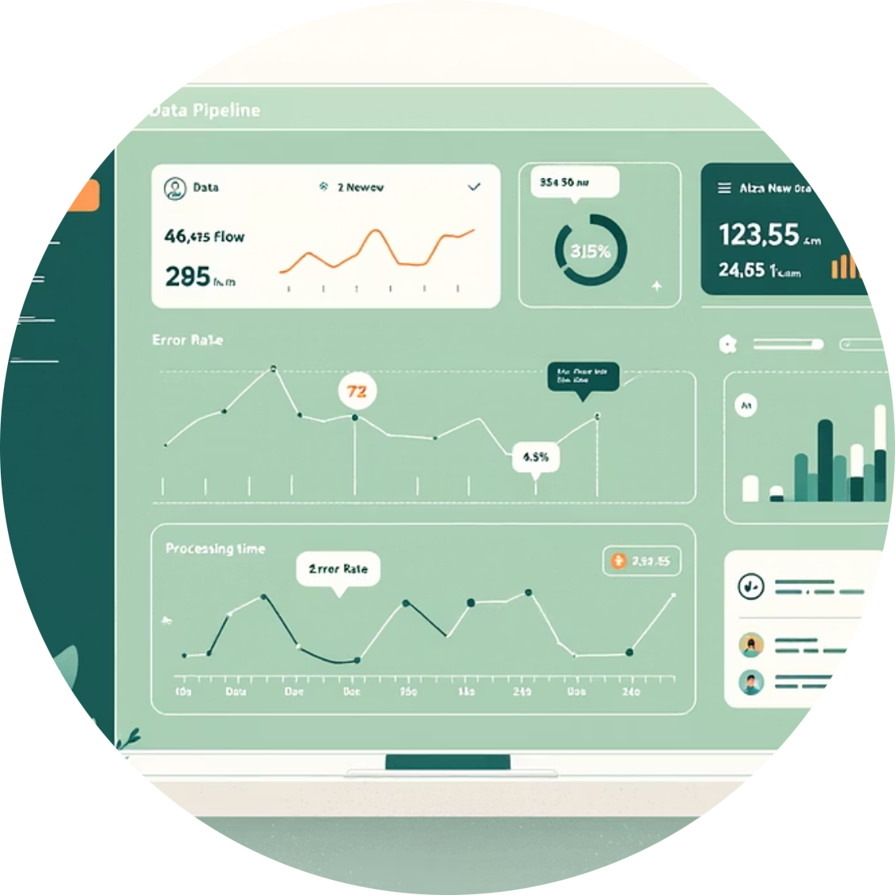

Implementation Checklist and Next Steps
Security & Governance
Monitoring & Alerting
Automation & Orchestration
Implement role-based access control
Track load history with INFORMATION_SCHEMA
Integrate with Airflow or similar tools
Set up column-level encryption for PII
Set up alerts for pipeline failures
Implement CI/CD for pipeline changes
Enable audit logging for compliance
Monitor credit consumption
Automate error recovery processes
Document data lineage for each pipeline
Implement data quality checks
Create idempotent loading processes
Ready to implement? Start with a proof of concept using a single data source, then scale your approach based on volume, velocity, and transformation requirements. Remember that the right approach often combines multiple loading techniques.

Slide 31
External Stages and File Formats
External Stages
File Formats
References to external cloud storage locations where your source data resides.
Specifications that tell Snowflake how to interpret your data files.
CREATE FILE FORMAT my_csv_format TYPE = 'CSV' FIELD_DELIMITER = ',' SKIP_HEADER = 1 NULL_IF = ('NULL', 'null') EMPTY_FIELD_AS_NULL = TRUE;
CREATE STAGE my_s3_stage URL='s3://my-bucket/data/' CREDENTIALS=(AWS_KEY_ID='...' AWS_SECRET_KEY='...') ENCRYPTION=(TYPE='AWS_SSE_S3');
You can also use AWS IAM roles for more secure authentication:
Supported types include:
CREATE STAGE my_s3_stage URL='s3://my-bucket/data/' STORAGE_INTEGRATION = my_aws_int;
CSV, TSV, JSON, Avro, ORC, Parquet, XML
Compressed files (GZIP)

Slide 32

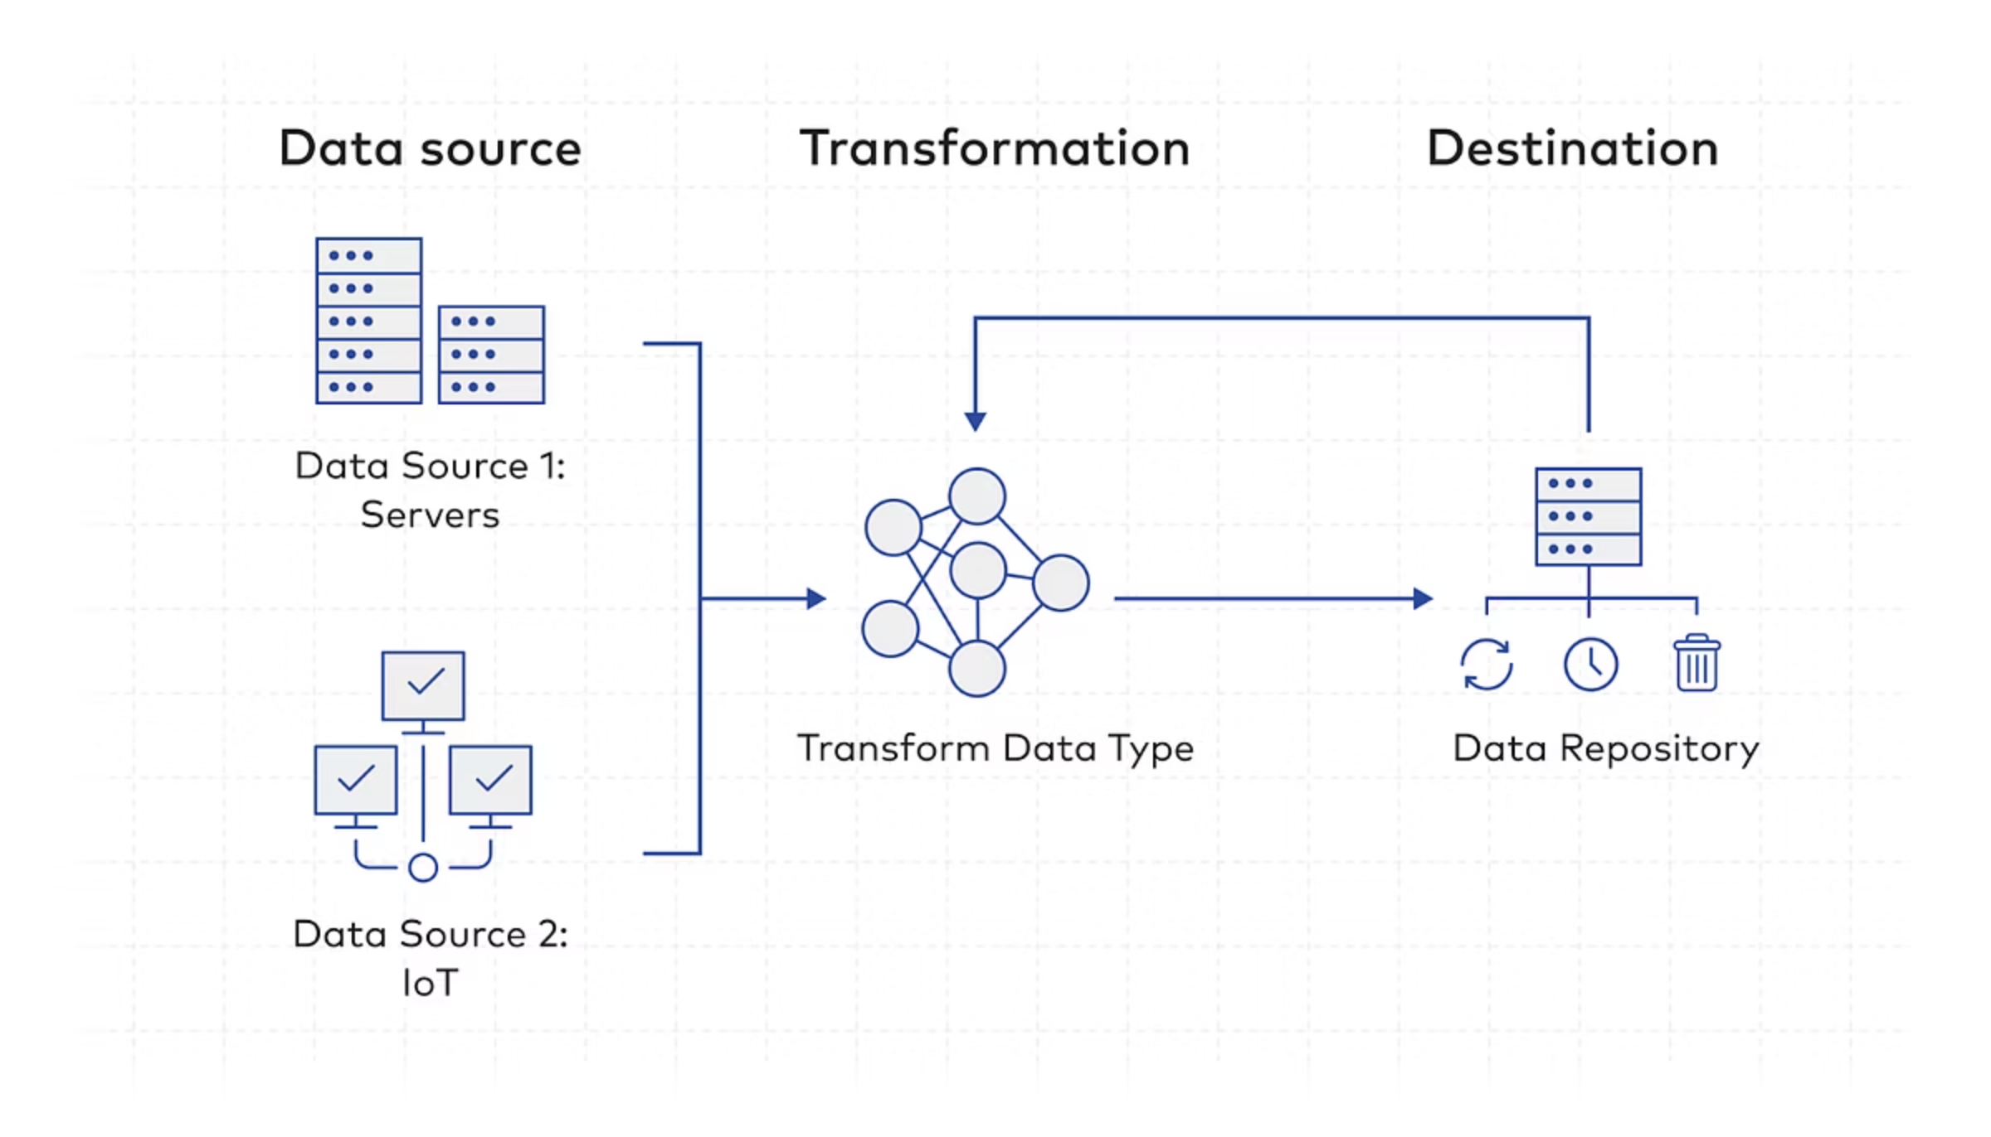
Loading Data Using COPY INTO
The COPY INTO command is Snowflake's primary bulk data loading mechanism, optimized for performance and flexibility.
COPY INTO sales.transactionsFROM @my_s3_stage/transactions/FILES = ('transactions_2023_01.csv', 'transactions_2023_02.csv')FILE_FORMAT = (FORMAT_NAME = my_csv_format)ON_ERROR = 'CONTINUE'VALIDATION_MODE = 'RETURN_ERRORS';
Key Features
Parallel loading across compute nodes for maximum performance
File pattern matching with wildcards
Data transformation during load (COPY with SELECT)
Error handling and validation options
Best Practices
Use compressed files (GZIP, BZ2) for faster transfers
Size files between 100-250 MB for optimal parallelism
Use column lists to enforce schema expectations
Consider using FORCE=TRUE for re-loads

Slide 33

Transforming Data During Load
Snowflake allows you to transform data on-the-fly during loading, eliminating the need for separate ETL processes.
COPY INTO sales.transactions( transaction_id, customer_id, transaction_date, amount, status)FROM ( SELECT $1, $2, TO_DATE($3, 'MM/DD/YYYY'), TO_DECIMAL($4, 10, 2), CASE WHEN $5 = 'C' THEN 'COMPLETED' WHEN $5 = 'P' THEN 'PENDING' ELSE 'UNKNOWN' END FROM @my_s3_stage/transactions/)FILE_FORMAT = (FORMAT_NAME = my_csv_format);
This approach, known as "ELT" (Extract, Load, Transform), leverages Snowflake's compute resources for transformation rather than external tools, simplifying your data pipeline and reducing points of failure.

Slide 34
Automating Ingestion with Snowpipe
What is Snowpipe?
Implementation
Snowflake's serverless, near real-time continuous data ingestion service.
-- Create the pipeCREATE PIPE sales.transactions_pipe AUTO_INGEST = TRUEASCOPY INTO sales.transactionsFROM @my_s3_stage/transactions/FILE_FORMAT = (FORMAT_NAME = my_csv_format);
Automatically loads new files as they arrive in your stage
Serverless compute - no warehouse required
Pay only for the data processed
Designed for frequent, smaller loads
When AUTO_INGEST=TRUE, Snowflake creates an SQS notification integration. Configure your S3 bucket to send notifications when new files arrive.
Snowpipe is ideal for applications requiring fresh data with minimal latency, such as real-time dashboards, operational reporting, and event-driven architectures.

Slide 35
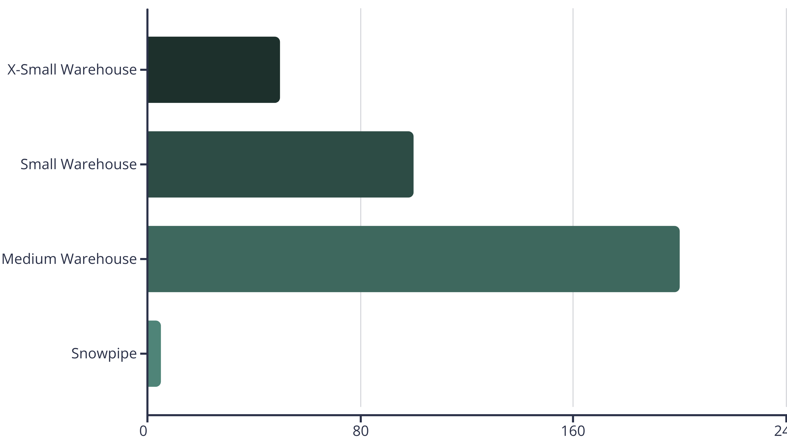
Bulk vs. Continuous Loading
Bulk Loading (COPY INTO with Warehouse)
Continuous Loading (Snowpipe)
Best for:
Best for:
Large historical data loads
Continuous streams of smaller files
Regular batch processing (daily, hourly)
Near real-time data availability requirements
When data freshness can wait for batch windows
Serverless operations (no warehouse management)
Complex transformations during load
Microservices and event-driven architectures
Uses a virtual warehouse for parallelized processing power
Automatically processes files as they arrive in your stage

Slide 36
Module 5: Understanding Stages in Snowflake
Mastering the staging areas for efficient data operations

Slide 37

Types of Stages in Snowflake
Internal Stages
Storage locations managed directly by Snowflake.
User stages: @~/ (private to each user)
Table stages: @%table_name (associated with specific tables)
Named stages: @stage_name (accessible across the account)
External Stages
References to external cloud storage services.
AWS S3 buckets
Google Cloud Storage
Microsoft Azure Blob Storage
Require proper authentication setup
Stages serve as the intermediary locations where data resides before being loaded into Snowflake tables or after being unloaded from tables. They provide a structured way to organize your data movement operations.

Slide 38
Working with S3 External Stages
Creating an External Stage
Key S3 Stage Features
Authentication options:
Create storage integration (account admin only)CREATE STORAGE INTEGRATION s3_int TYPE = EXTERNAL_STAGE STORAGE_PROVIDER = S3 ENABLED = TRUE STORAGE_AWS_ROLE_ARN = 'arn:aws:iam::123456789012:role/snowflake-access’
STORAGE_ALLOWED_LOCATIONS = ('s3://my-bucket/data/');-- Create the stage using the integrationCREATE STAGE marketing.campaign_data STORAGE_INTEGRATION = s3_int URL = 's3://my-bucket/data/campaigns/' FILE_FORMAT = (TYPE = 'PARQUET');
Storage Integration (recommended)
AWS Key/Secret (legacy)
Security features:
Encryption in transit
AWS SSE-S3/SSE-KMS support
Access restricted by allowed locations
Performance optimization:
Regional co-location
Parallel operations
Using storage integrations provides better security by avoiding hardcoded credentials and leveraging IAM roles for authentication.

Slide 39
File Format Options and Compression
CSV/TSV
JSON
Row-based text format
Flexible schema
Human-readable
Nested structures
Highly configurable (delimiters, quote characters, etc.)
Human-readable
Less efficient than binary formats
Good for semi-structured data
Parquet
Avro/ORC
Columnar storage
Row/columnar binary formats
Efficient compression
Schema definitions
Schema evolution
Hadoop ecosystem compatibility
Best for analytics workloads
Efficient storage
Compression Options
GZIP: Good compression ratio, widely supported
ZSTD: Excellent balance of speed and compression
BZ2: Higher compression ratio, slower to process
BROTLI: High compression ratio for text
CREATE FILE FORMAT parquet_zstd TYPE = 'PARQUET' COMPRESSION = 'ZSTD';

Slide 40
PUT and GET Commands for File Transfer
PUT Command
GET Command
Uploads local files to a Snowflake stage.
Downloads files from a Snowflake stage to local storage.
PUT file:///path/to/local/file.csv @my_stage AUTO_COMPRESS = TRUE OVERWRITE = TRUE;
GET @my_stage/data/file.csv file:///path/to/local/directory/ DECOMPRESS = TRUE;
Key features:
Key features:
Automatically compresses files during upload
Automatically decompresses files during download
Parallel uploads for large files
Parallel downloads for large files
Supports pattern matching
Supports pattern matching
Can be executed from SnowSQL CLI or connectors
Can be executed from SnowSQL CLI or connectors
PUT and GET are client-side commands that establish a secure connection between your local environment and Snowflake. They're ideal for working with smaller files or when you need direct file transfer without using cloud storage services.

Slide 41



Key Takeaways
3
2
4
Object Types
Loading Methods
Stage Types
Permanent, Transient, and Temporary tables provide options for different data persistence needs and cost considerations.
COPY INTO (bulk) and Snowpipe (continuous) offer flexible approaches to data ingestion based on your requirements.
User, Table, Named, and External stages provide various options for organizing your data movement operations.
Next Steps
Complete the hands-on lab to practice creating objects and loading data
Review the documentation for advanced options and best practices
Consider the Snowflake SnowPro Core certification to validate your knowledge

Slide 42

Mastering Snowflake Stages for Efficient Data Operations
A comprehensive guide for data engineers and cloud architects to understand, implement, and optimize Snowflake staging operations for enterprise-level data pipelines.

Slide 43
Agenda
1
Understanding Stage Types in Snowflake
2
Stage Configuration Best Practices
Internal, external, user, and table stages
File formats, compression, and security
3
Data Operations with Stages
4
Enterprise Implementation Patterns
PUT, GET commands and advanced techniques
Real-world architectures and optimization strategies

Slide 44
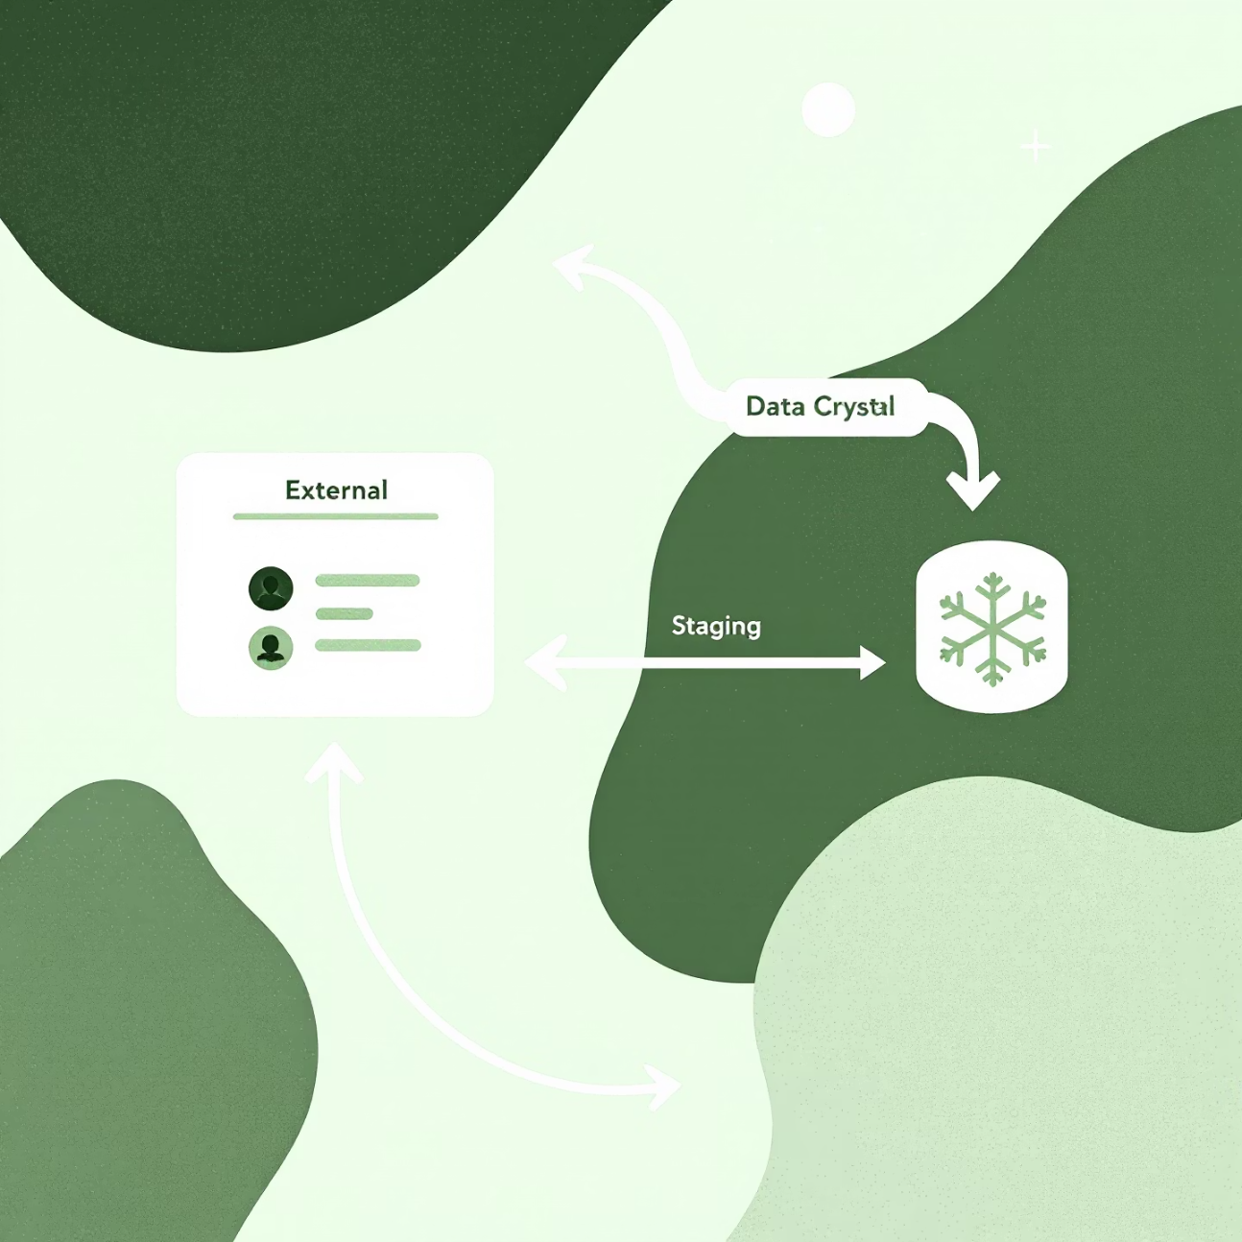
What Are Snowflake Stages?
Stages in Snowflake are locations where data files are stored before loading into or after unloading from Snowflake tables. They serve as the intermediate storage layer in the data loading/unloading process.
Stages are crucial components in your data pipeline architecture that enable:
Structured data loading workflows
Separation of storage and compute concerns
Controlled data movement between systems
Audit trails for data operations

Slide 45
The Four Types of Snowflake Stages
1
2
Internal Stages
External Stages
Managed entirely within Snowflake's storage. Best for temporary staging needs with automatic management. Storage is charged as part of your Snowflake account.
References external cloud storage (primarily S3). Ideal for persistent storage needs and cross-platform integration. Storage costs are handled by your cloud provider.
CREATE STAGE my_internal_stage;
CREATE STAGE my_s3_stage URL='s3://bucket/path/'
3
4
User Stages
Table Stages
Automatically created for each user. Accessed with the @~ prefix. Perfect for personal development work and ad-hoc operations.
Automatically created for each table. Accessed with @%table_name. Optimized for operations specific to a single table.
PUT file:///path/to/local/file.csv @~;
PUT file:///path/to/local/data.csv @%my_table;

Slide 46

External Stages with S3: Deep Dive
Key Configuration Parameters
Example S3 Stage Configuration
URL: S3 bucket path (required)
CREATE STORAGE INTEGRATION s3_int TYPE = EXTERNAL_STAGE STORAGE_PROVIDER = S3 ENABLED = TRUE STORAGE_AWS_ROLE_ARN = 'arn:aws:iam::001234567890:role/snowflake_role' STORAGE_ALLOWED_LOCATIONS = ('s3://mybucket/path/');CREATE STAGE ext_stage STORAGE_INTEGRATION = s3_int URL = 's3://mybucket/path/' FILE_FORMAT = (TYPE = 'CSV' FIELD_DELIMITER = '|');
CREDENTIALS: AWS access methods
ENCRYPTION: Client-side encryption options
STORAGE_INTEGRATION: Recommended for enterprise security
Best Practice: Use storage integrations instead of embedding credentials to maintain security and simplify IAM management.

Slide 47

File Format Options and Best Practices
CSV/TSV
JSON
Widely compatible, but larger file sizes. Best for simple data structures.
Excellent for semi-structured data. Supports nested structures. Use with VARIANT columns.
TYPE = 'CSV', FIELD_DELIMITER = ',', SKIP_HEADER = 1
TYPE = 'JSON', STRIP_OUTER_ARRAY = TRUE
Parquet
Avro/ORC
Recommended for production. Columnar format with built-in compression. Up to 4x more efficient than CSV.
Row-based (Avro) and columnar (ORC) formats with schema evolution support. Good for Hadoop ecosystem integration.
TYPE = 'PARQUET'

Slide 48


Compression Options for Staged Files
Snowflake supports multiple compression formats for staged files, which can significantly reduce storage costs and improve load performance.
Supported Compression Types
GZIP: Widely supported, good compression ratio (default)
BZ2: Better compression than GZIP, but slower
BROTLI: Excellent balance of speed and compression
ZSTD: Recommended for production, best overall performance
DEFLATE: Similar to GZIP, different algorithm
RAW_DEFLATE: DEFLATE without headers
NONE: No compression, only for testing
In our benchmarks, ZSTD achieved 20% better compression than GZIP while being 30% faster for large datasets.

Slide 49


Secure File Transfer with PUT and GET Commands
PUT Command
GET Command
Uploads local files to a Snowflake stage
Downloads files from a Snowflake stage to local storage
PUT file:///path/to/local/file.csv @my_stage AUTO_COMPRESS = TRUE OVERWRITE = TRUE;
GET @my_stage/data.csv file:///path/to/local/ PATTERN = '.*csv.gz';
Security Considerations
All file transfers are encrypted in transit using TLS. For sensitive data, consider using client-side encryption with the ENCRYPTION= parameter in your stage definition. Leverage Snowflake's role-based access control to restrict stage access to appropriate users.

Slide 50

Advanced Stage Operations
List Files in Stage
Unload Data to Stage
LIST @my_stage PATTERN = '.*parquet';
COPY INTO @my_stage/export/ FROM my_tableFILE_FORMAT = (TYPE = PARQUET)HEADER = TRUE;
Remove Files from Stage
REMOVE @my_stage/old_data/;
Stage Monitoring
Query metadata with:
Copy Data from Stage to Table
SELECT * FROM information_schema.filesWHERE stage_name = 'MY_STAGE'AND stage_schema = 'MY_SCHEMA';
COPY INTO my_table FROM @my_stage/data/ PATTERN = '.*parquet'FILE_FORMAT = (TYPE = PARQUET);

Slide 51
Enterprise Implementation Patterns
Multi-Environment Architecture
Landing Zone Pattern
Integration with AWS Services
Create separate stages for development, testing, and production environments to ensure isolation. Use consistent naming conventions:
Implement a three-tiered staging approach:
Connect stages with S3 event notifications, Lambda functions, and Step Functions to create automated workflows:
Raw Stage: Initial landing for unmodified files
Validated Stage: Files that passed validation
S3 → Lambda → Snowpipe → Snowflake Tables
dev_raw_stage, test_raw_stage, prod_raw_stage
Archive Stage: Historical file retention
Snowflake Tasks → External Stages → S3 → Other AWS Services

Slide 52
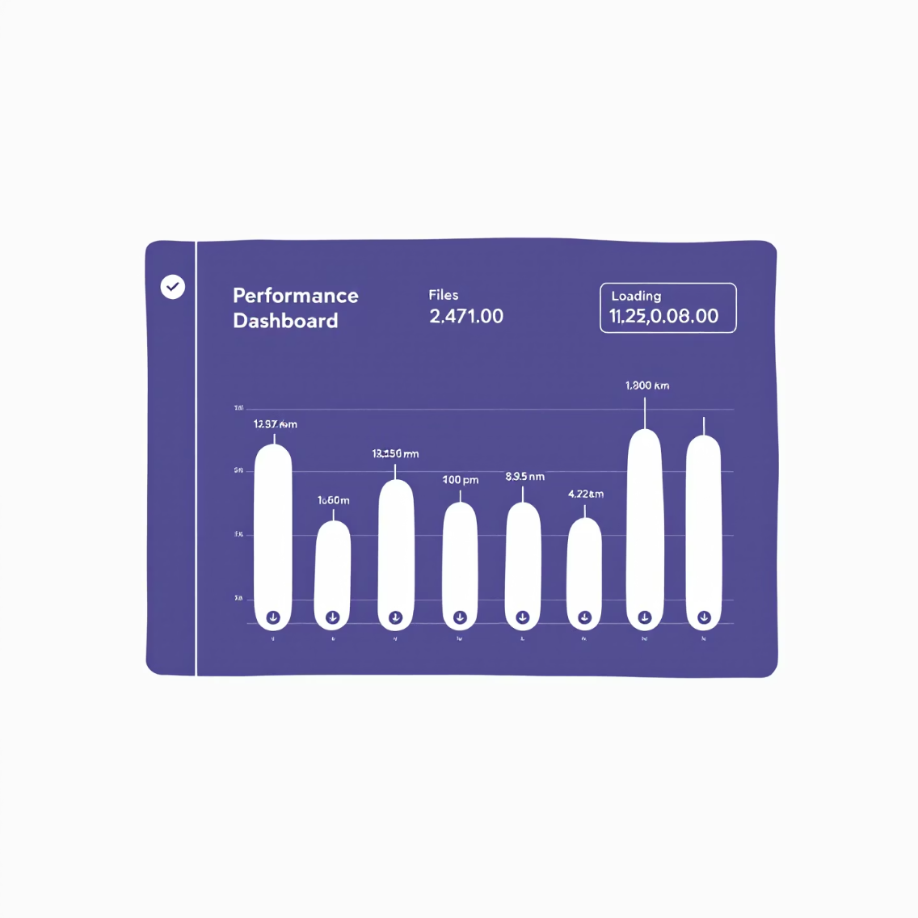

Performance Optimization for Stages
Key Performance Factors
File Size: Aim for 100-250MB compressed files. Too small (<10MB) or too large (>1GB) files reduce performance.
Partitioning: Organize stage files by date/region to enable pattern-based loading and pruning.
Compression: Always compress files. ZSTD offers the best balance of speed and size.
File Format: Parquet outperforms CSV by 3-5x for complex datasets.
Warehouse Sizing: Match your warehouse size to your data volume. More data requires larger warehouses.
Parallel Loading: Split large datasets into multiple files to enable parallel loading.
By implementing these optimizations, one client reduced their daily load times from 4 hours to 20 minutes while reducing storage costs by 40%.

Slide 53




Key Takeaways
Choose the Right Stage Type
Optimize File Formats
External stages with S3 for enterprise workloads and persistence. Internal stages for ephemeral or smaller datasets.
Use Parquet with ZSTD compression for production workloads. Consider your data structure when selecting formats.
Secure Your Data Pipeline
Follow Size Guidelines
Implement storage integrations, avoid hardcoded credentials, and enforce least privilege access to stages.
Maintain 100-250MB file sizes and implement partitioning strategies for optimal loading performance.
Next Steps
Audit your current stage configurations against these best practices
Implement a standardized stage naming convention across environments
Consider automating your data pipelines with Snowpipe for continuous loading

